Slide 1
Comparative Study of Sentiment Analysis with Product Reviews
Rashed Iqbal
Aravind Veluchamy
Heidi Nguyen
Mamadou Lamine Diop

Slide 2
Problem Statement
In order to understand how e-commercial customers evaluate a product or a service, it is important to extract sentiment in a efficient and cost effective way.

Slide 3
Why Do We Want to Do Sentiment Analysis?
Product review from customers has a treasure trove of information:
It helps manufacturers to get feedback to improve existing products/services.
It may prompt the manufacturer to conduct more in depth analyses to develop new products/services.

Slide 4
Goal of this Paper
Perform a comparative study of various approaches to sentiment analysis using NLP.

Slide 5
Techniques
Supervised machine learning
Unsupervised lexicon-based

Slide 6
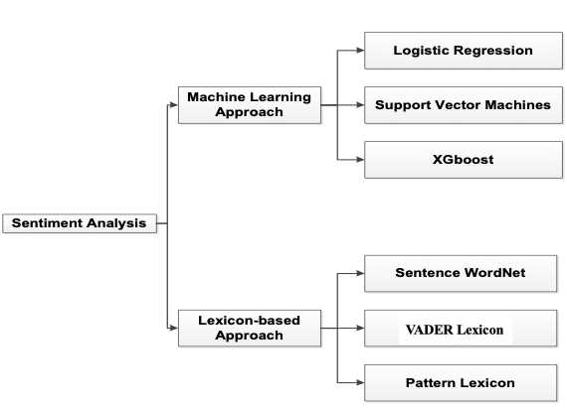
Techniques (cont’d)

Slide 7
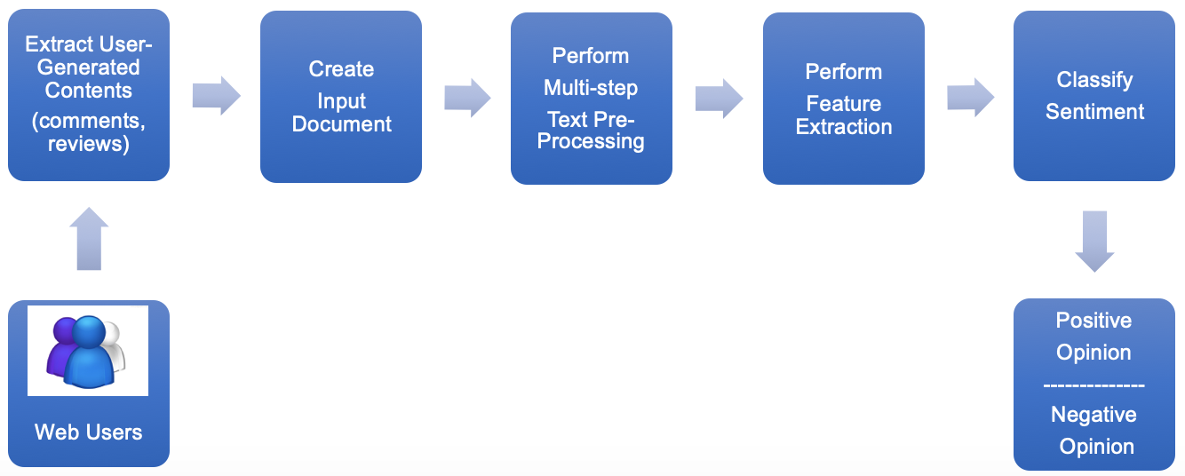
Natural Language Processing
NLP Pipeline

Slide 8
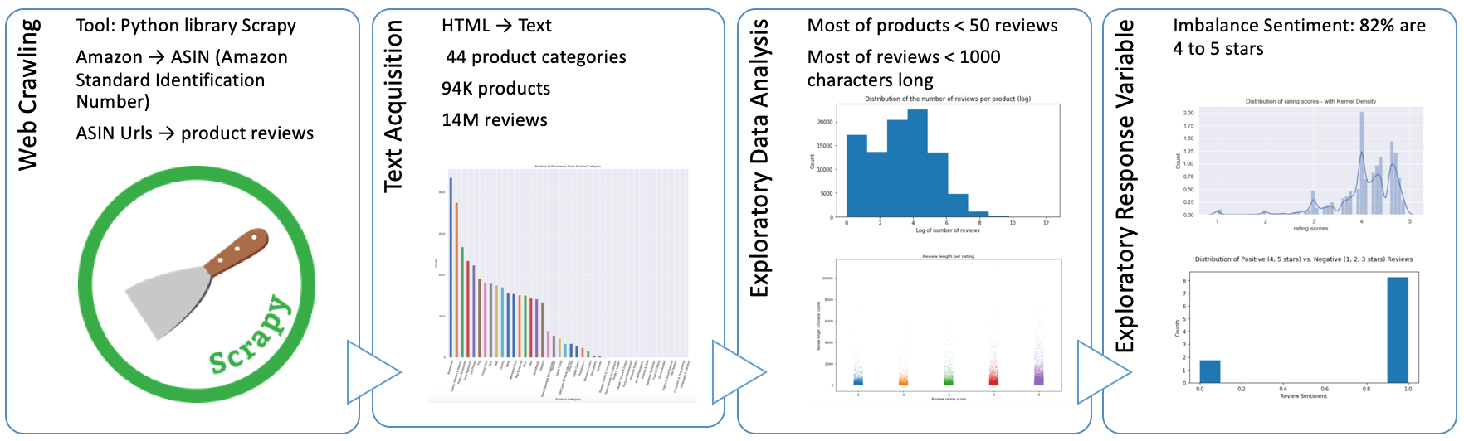
Data Acquisition

Slide 9
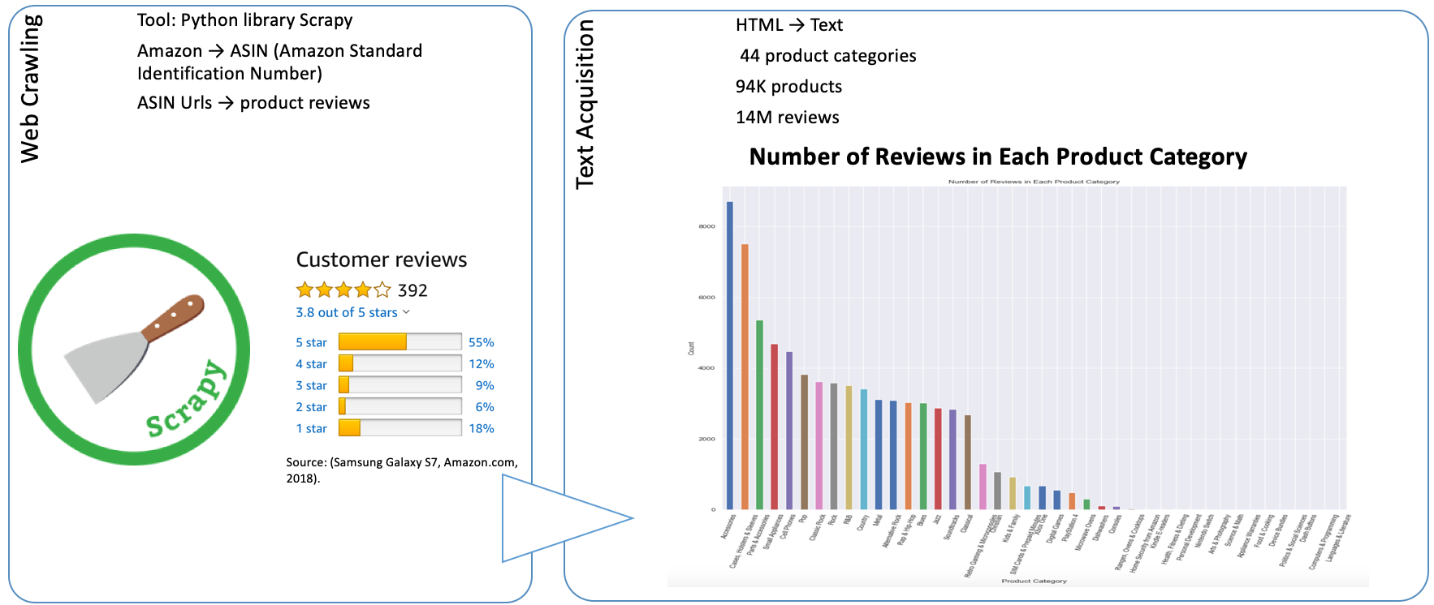
Data Acquisition
Web Crawling

Slide 10
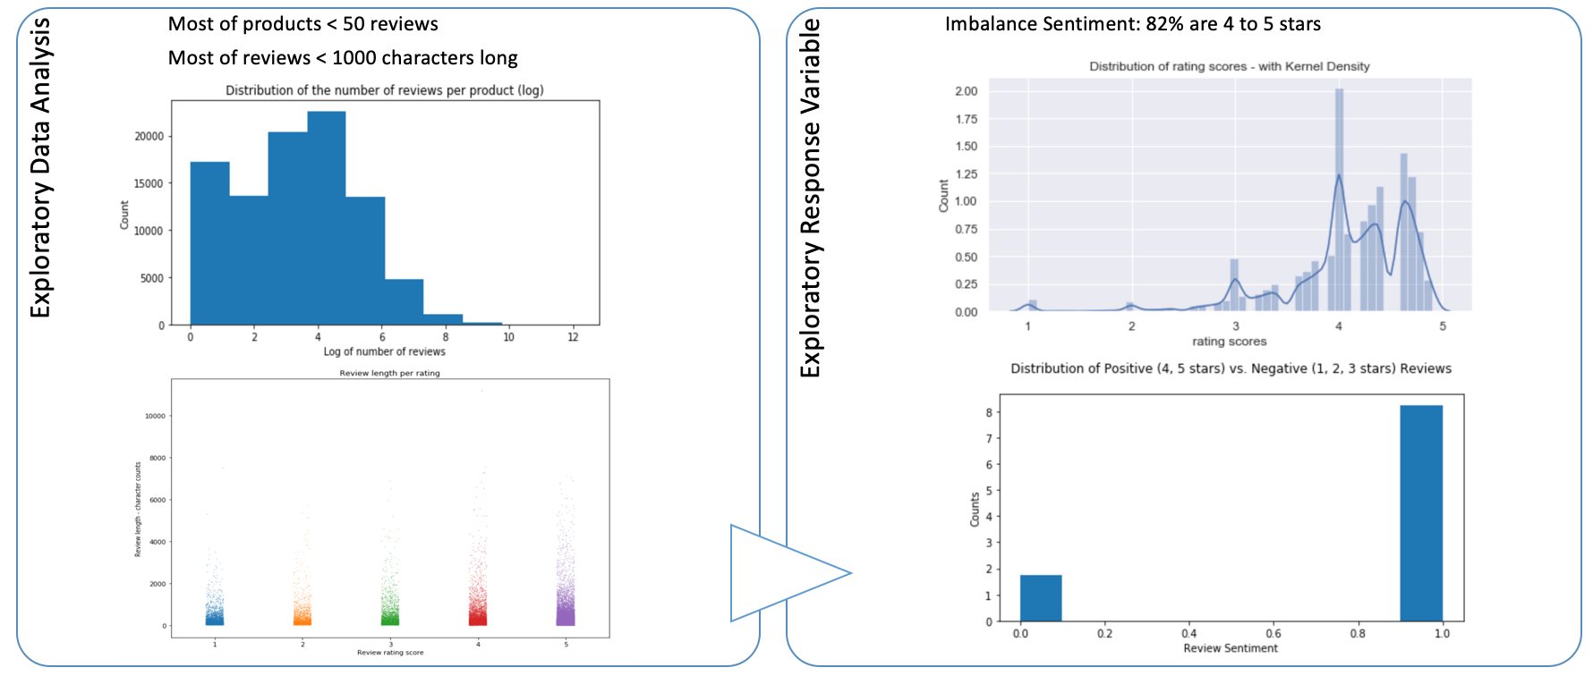
Data Acquisition
Exploratory Data Analysis

Slide 11
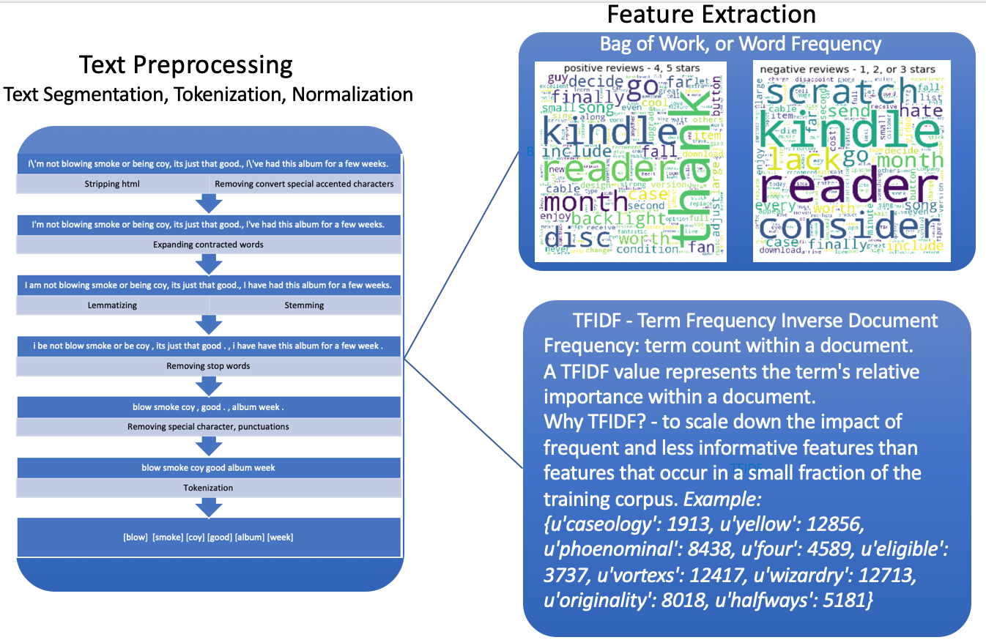
Pre-Processing and Feature Extraction

Slide 12
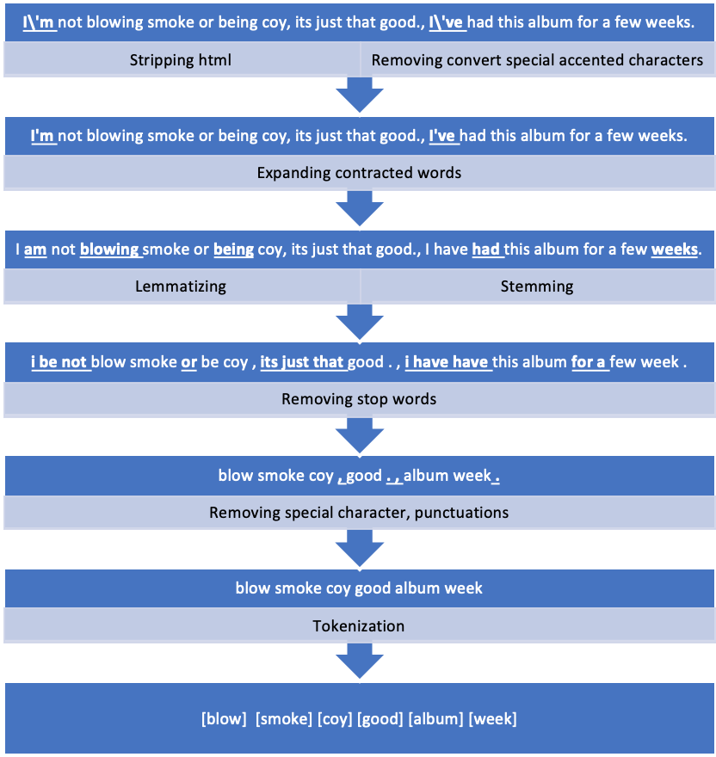
Text Pre-Processing

Slide 13
Text Pre-Processing (cont’d)

Slide 14
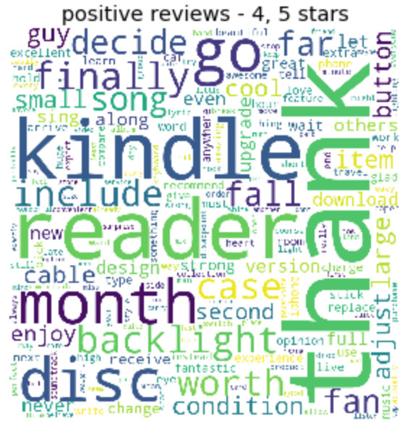
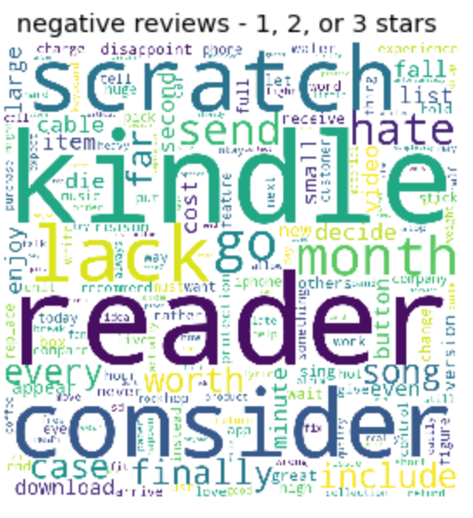
Bag of Words - Term Frequency
The probability distribution of words in document.

Slide 15
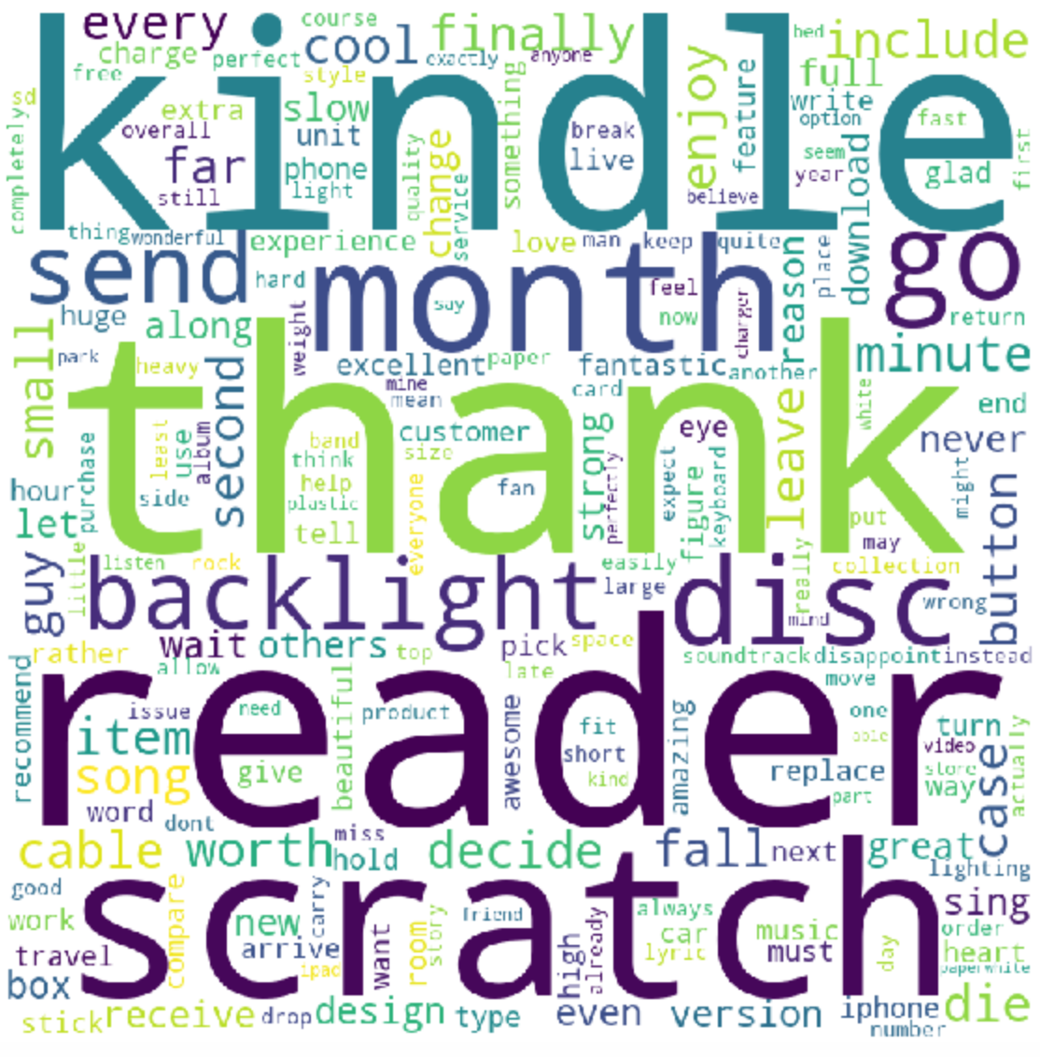
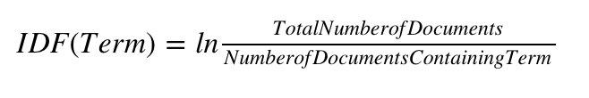
Term Frequency Inverse Document Frequency
X
=
ID-IDF
TF: the weight for each word is equal to its frequency of occurrence in that document.
IDF: value represents a term's relative importance within a document.

Slide 16
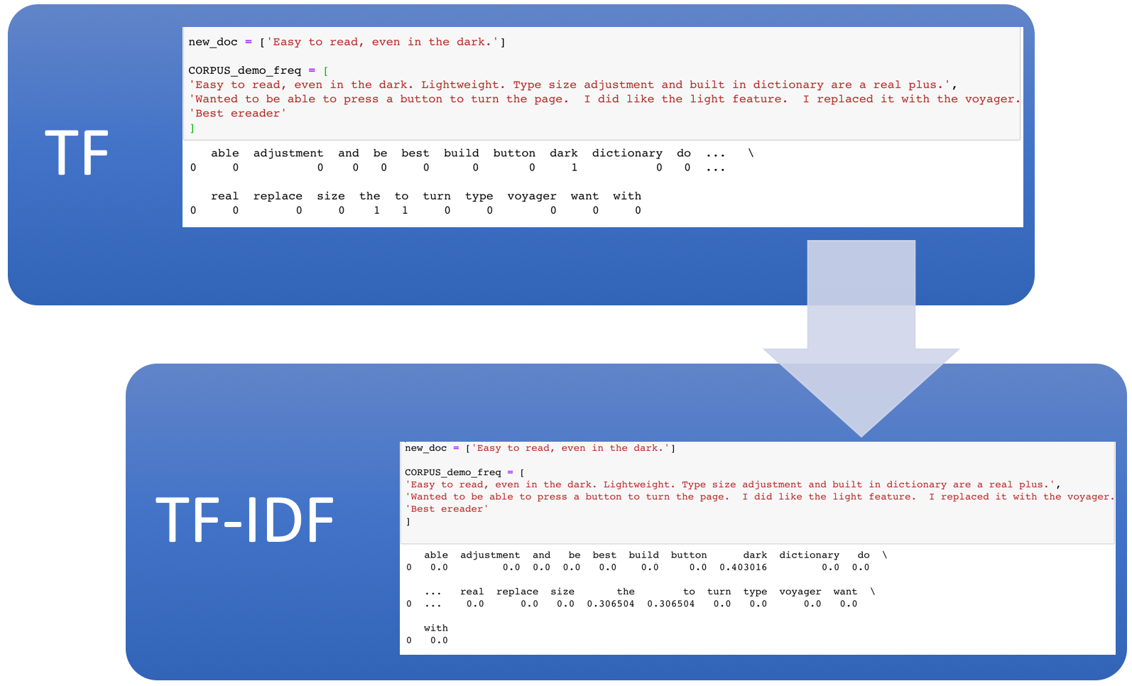
Why TFIDF?
To scale down the impact of frequent and less informative features than features that occur in a small fraction of the training data.

Slide 17
Training and Splitting
Split data 80/20 for training/testing.
Both training and testing go through text pre-processing and IFIDF feature extraction.

Slide 18
Modelling
Supervised Machine Learning
Support Vector Machine
Logistic Regression
Gradient Boosting

Slide 19
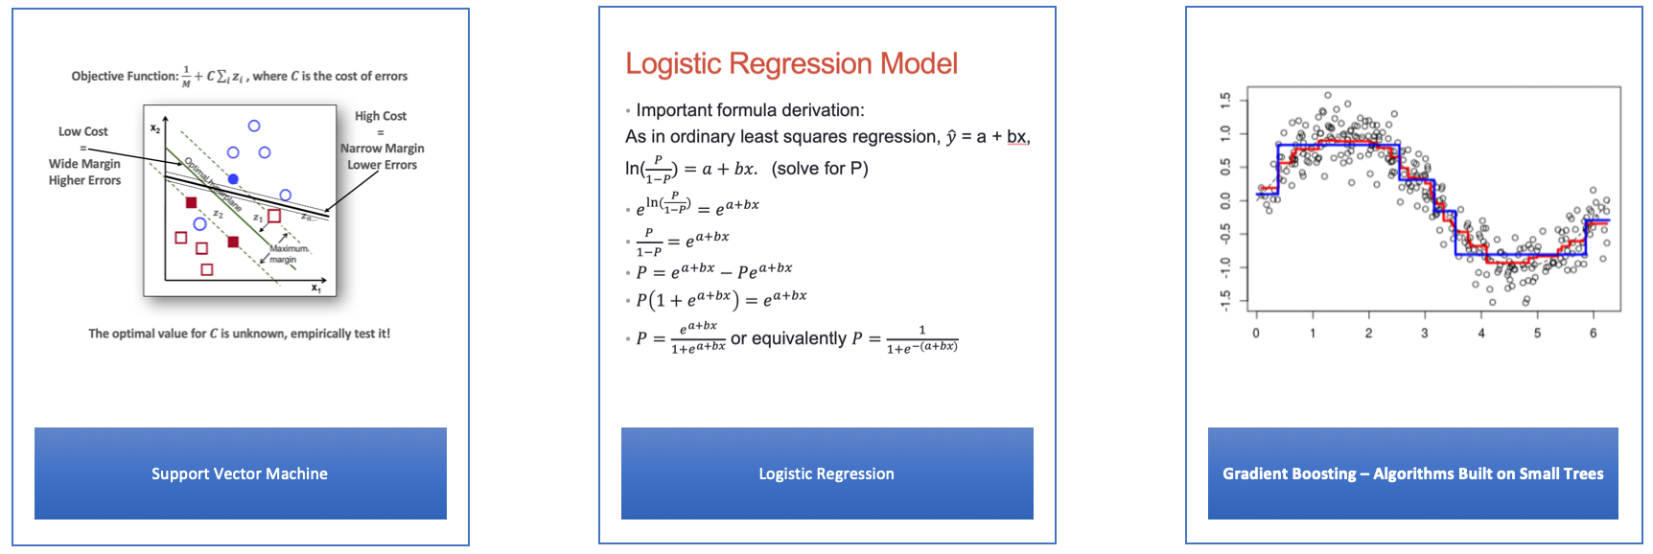
Supervised Machine Learning
Source: (Jake Drew Ph.D., 2017).

Slide 20
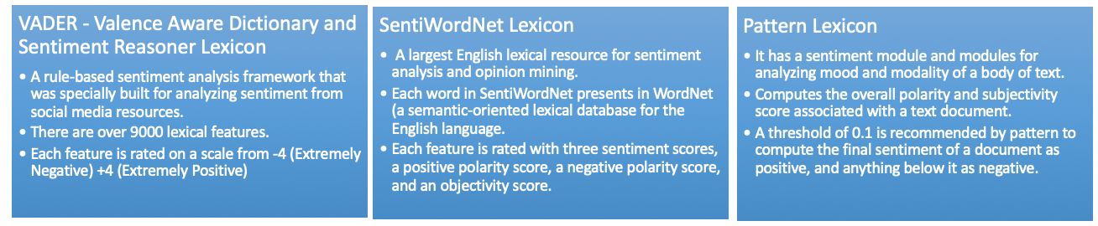
Unsupervised Lexicon-Based
Popular Lexicons for Sentiment Analysis

Slide 21
VADER Lexicon
VADER - Valence Aware Dictionary and Sentiment Reasoner Lexicon
A rule-based sentiment analysis framework that was specially built for analyzing sentiment from social media resources.
There are over 9000 lexical features (e.g. words)
Each feature is rated on a scale from -4 (Extremely Negative) +4 (Extremely Positive)

Slide 22
SentiWordNet Lexicon
The largest English lexical resource for sentiment analysis and opinion mining.
Each word in SentiWordNet is present in WordNet (a semantic-oriented lexical database for the English language).
Each feature is rated with 3 sentiment scores: a positive polarity score, a negative polarity score, and an objectivity score.

Slide 23
Pattern Lexicon
Pattern Package: a package for NLP, text analytics, and information retrieval.
It has a sentiment module and modules for analyzing mood and modality of a body of text.
Computes the overall polarity and subjectivity score associated with a text document.
A threshold of 0.1 is recommended by pattern lexicon to compute the final sentiment of a document as positive, and anything below it as negative.

Slide 24
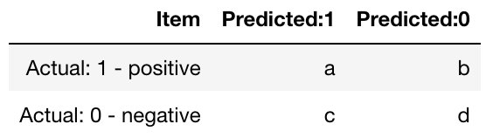
Evaluation Metrics
Confusion Matrix: a table that is often used to describe the performance of a classification model.

Slide 25
Confusion Matrix (Cont’d)
True positives (TP): correct predictions that an instance is positive
True negatives (TN): correct predictions that an instance is negative
False positives (FP): incorrect predictions that an instance is positive
False negatives (FN): incorrect of predictions that an instance negative

Slide 26
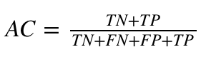
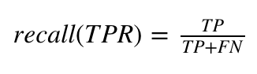
Evaluation Metrics
Accuracy: the proportion of the total number of predictions that are correct.
Recall: tells how often an actual True instance is predicted to be True.
We want a moderate recall since it is more costly to predict negative wrong.
We want FN to be minimized while still accurately labeling them as TP.

Slide 27
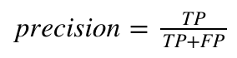
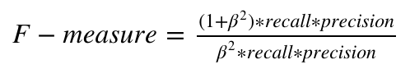
Evaluation Metrics
Precision: the proportion of the predicted positive cases that are correct.
F1-Score: is a weighted average of the precision and recall, the trade-offs of precision and recall.
We want a high precision with FP to be minimized since it is more costly to predict negative wrong. However, the cost of improving recall could cause precision to be worse.

Slide 28
Results
Model | Accuracy | Precision | Recall | F1 Score | Confusion Matrix
Pattern Lexicon | 0.69 | 0.88 | 0.72 | 0.79 | [[5063, 2015], [688, 958]]
Vader Lexicon | 0.82 | 0.90 | 0.88 | 0.89 | [[6237, 841], [716, 930]]
SentiWordNet | 0.80 | 0.86 | 0.90 | 0.88 | [[6367, 711], [1043, 603]]
Support Vector Machine | 0.89 | 0.89 | 0.98 | 0.93 | [[6942, 136], [837, 809]]
Gradient Boosting | 0.88 | 0.89 | 0.97 | 0.93 | [[6887, 191], [863, 783]]
Logistic Regression | 0.89 | 0.90 | 0.97 | 0.94 | [[6892, 186], [765, 881]]

Slide 29
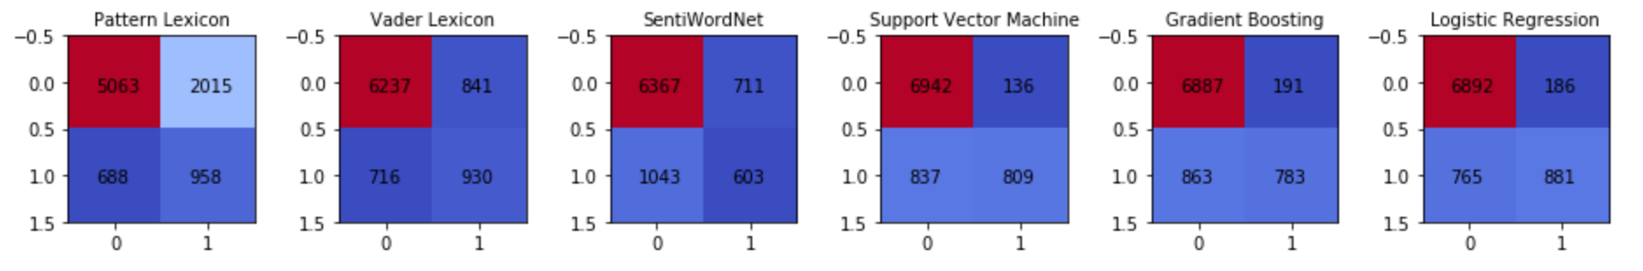
Results (cont’d)
Confusion Matrix Comparison
Pattern lexicon performs best in term of predicting true negative correctly.
Surprisingly, SentiWordNet performs worse in terms of predicting true negative correctly.
Machine learning models performs very well in terms of predicting true positive and moderately in terms of predicting true negative

Slide 30
Comparison of Performance

Slide 31
Conclusions
Supervised Machine Learning Techniques tend to do a better job of predicting reviews as having a positive or negative sentiment.
The Lexicon based approach is close to the machine learning approach in terms of accuracy.

Slide 32
Conclusions (Cont’d)
The Lexicon based approach has better precision but lower F1-score
Since the data has an imbalance and has 82% positive reviews, SVM is the best model. It has the highest accuracy, precision and recall amongst the models that were considered.

Slide 33
Future Directions
Although sentiment analysis gives general insight, it is limited as it divides the data points into only a negative and positive opinion.
For further Analysis we could expand scope of this paper to include emotion extraction.

Slide 34
Reference
Samsung Galaxy S7, Customer Reviews. Retrieve from https://www.amazon.com/product-reviews/B01F48QLFA. October 29, 2018.
Drew, J.: Data Mining Introduction. Lecture Notes in Data Science, Southern Methodist University (2017)

